Slide 1



Marihebert Leal

Slide 2
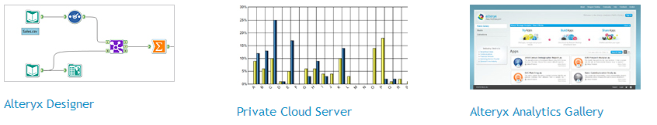
-The leader in data blending and advance analytics software
Alteryx is the fastest analytics plataform that is purpose- built to empower data analysts & their productivity.
It blend complex data, build analytics in a much easier way than tools like SAS, and simplify how analytics insights are consumed by business users.
Save time and enable your business to make the right decision faster at a lower cost
Alteryx empowers analysts to create workflows with the Alteryx Designer and allows business users to consume analytics apps in either a private cloud or the Alteryx Analytics Gallery

Slide 3




-The leader in data blending and advance analytics software
Analysts can access the full range of data source needed for analytics
Provide an intuitive workflow that delivers the data blending and data preparation capabilities required for predictive analytics
Analysts can choose to output their results to a multitude of file formats, create and distributes formatted reports, and even create analytic apps for business users
Analysts can rapidly prepare spatial data (with capabilities such as geocoding, cleansing and blending) and then deliver critical spatial insight such as trade areas, drives times and mapping.

Slide 4
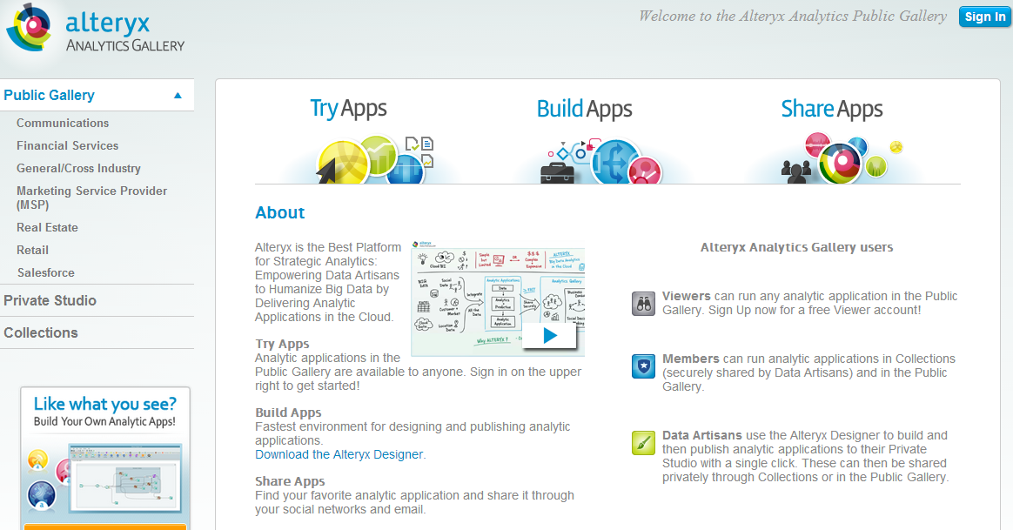
-The leader in data blending and advance analytics software

Slide 5


-The leader in data blending and advance analytics software
Deliver a comprehensive solution for strategic analytics that let you share your analytic applications with business decision makers, empowering everyone in your organization
Powerfull Capabilities- integrated with your People and processes
Make full use of the Alteryx Strategic Analytics Plataform

Slide 6

-The leader in data blending and advance analytics software
Putting Big Data and Custumer Analytics into the hands of the business
Alteryx Strategic Analytics 8.6 empowers Data Artisan like you to humanize Big data through an even easier way to create analytic applications, delivering analytics in the formats that business users demand, and delivering new ways to interact with analytic apps.

Slide 7

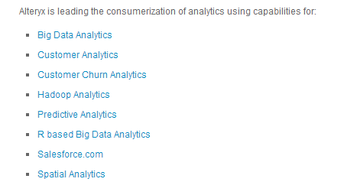
-The leader in data blending and advance analytics software

Slide 8




Amazon Web Services provides a highly reliable, scalable, low cost infrastructure platform in the cloud that powers hundreds of thousands of business in 190 countries around the world. With data center locations in the U.S., Europe, Brazil, Singapore, Japan, and Australia, customers across all industries are taking advantage of the following benefits:

Slide 9

Compute
  Amazon Elastic Compute Cloud(EC2)
  Elastic Load Balancing
  Auto Scaling
  Amazon WorkSpaces
Analytics
  Amazon Elastic MapReduce
  Amazon Kinesis
  AWS Data Pipeline
Deployments and Management
  AWS Identity and Access Management
  Amazon CloudWatch
  AWS CloudTrail
  AWS Elastic BeanStalk
  AWS CloudFormation
  AWS CloudHSM
  AWS OpsWorks
Application Services
  Amazon AppStream
  Amazon CloudSearch
  Amazon Simple Workflow Service (Amazon SWF)
  Amazon Simple Queue Service (Amazon SQS)
  Amazon Simple Notification Service (Amazon SNS)
  Amazon Simple Email Service (Amazon SES)
  Amazon Elastic Transcoder
Payments and billing
  Amazon Flexible Payment Service (FPS)
  Amazon DevPay
Software
  AWS Marketplace
Networking
  Amazon Route 53
  AWS Direct Connect
  Amazon Virtual private Cloud (VPC)

Slide 10
Content Delivery
  Amazon Cloud Front
Database
  Amazon Rational database Service (Amazon RDS)
  Amazon DinamoDB
  Amazon RedShift
  Amazon ElasticCache
  Amazon SimpleBD
Storage
  Amazon Simple Storage Service (S3)
  Amazon Glacier
  AWS Storage Gateway
  Amazon Elastic Block Store (Amazon EBS)
  AWS Import/Export
Support
  AWS support
Web Traffic
  Alexa Web Information Service
  Alexa Top Sites
Workforce
  Amazon Mechanical Turk

Slide 11

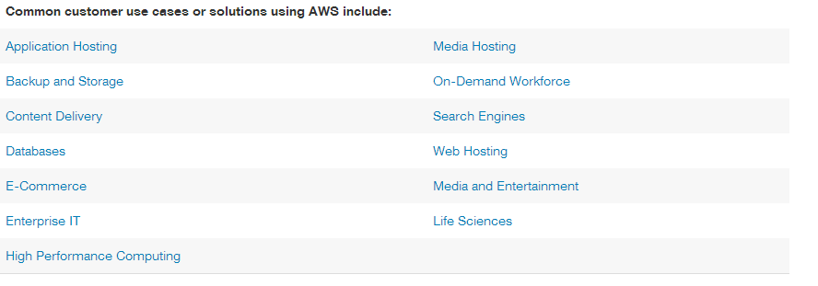

Slide 12






Machine Learning for Everyone

Slide 13
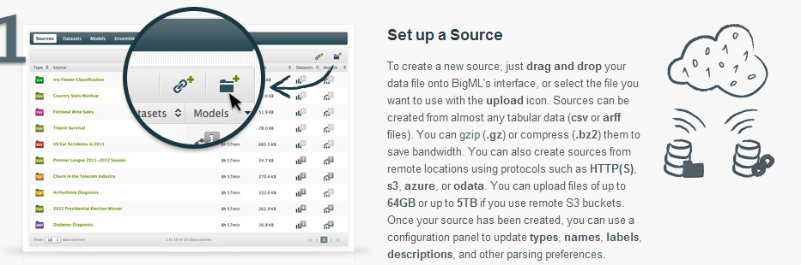
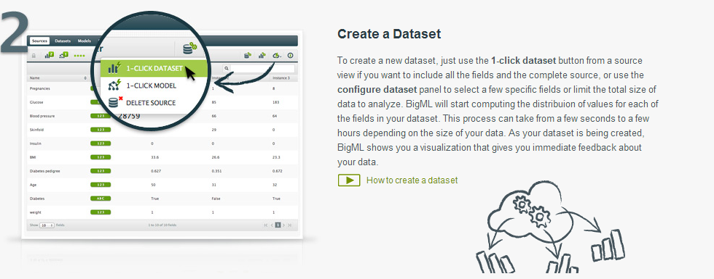
How it works?

Slide 14
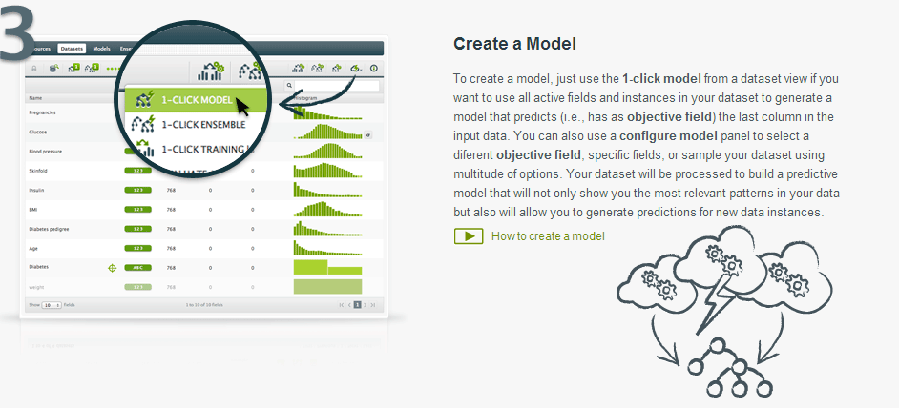
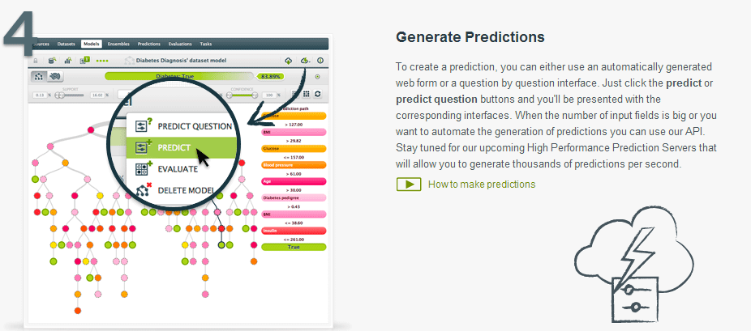

Slide 15
